Slide 1
Solving General Steiner Tree Problem Using Quantum Annealing
Author: Nguyen Duc Kien
VNU University of Engineering and Technology

Slide 2
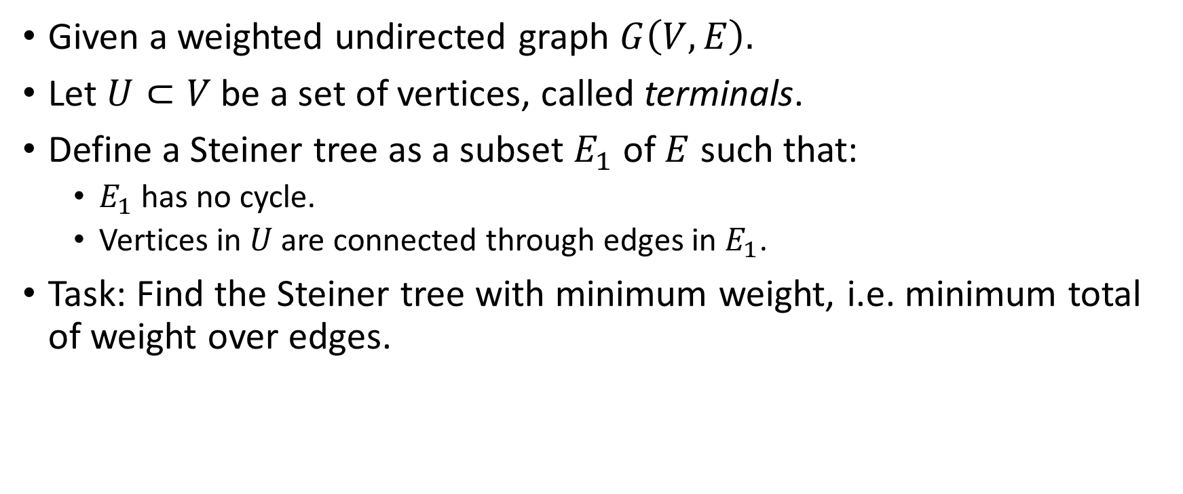
Problem Description
Given a weighted undirected graph $G\left(V, E\right).$
Let $U⊂V$ be a set of vertices, called terminals.
Define a Steiner tree as a subset $E_{1}$ of $E$ such that:
$E_{1}$ has no cycle.
Vertices in $U$ are connected through edges in $E_{1}$.
Task: Find the Steiner tree with minimum weight, i.e. minimum total of weight over edges.

Slide 3
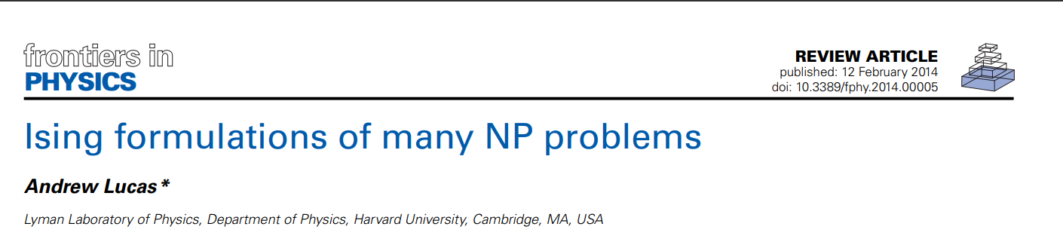
Lucas’ Solution
Many solutions exists
Uses Lucas’ solution, cited in Lucas A (2014) Ising formulations of many NP problems. Front. Physics 2:5. doi: 10.3389/fphy.2014.00005

Slide 4
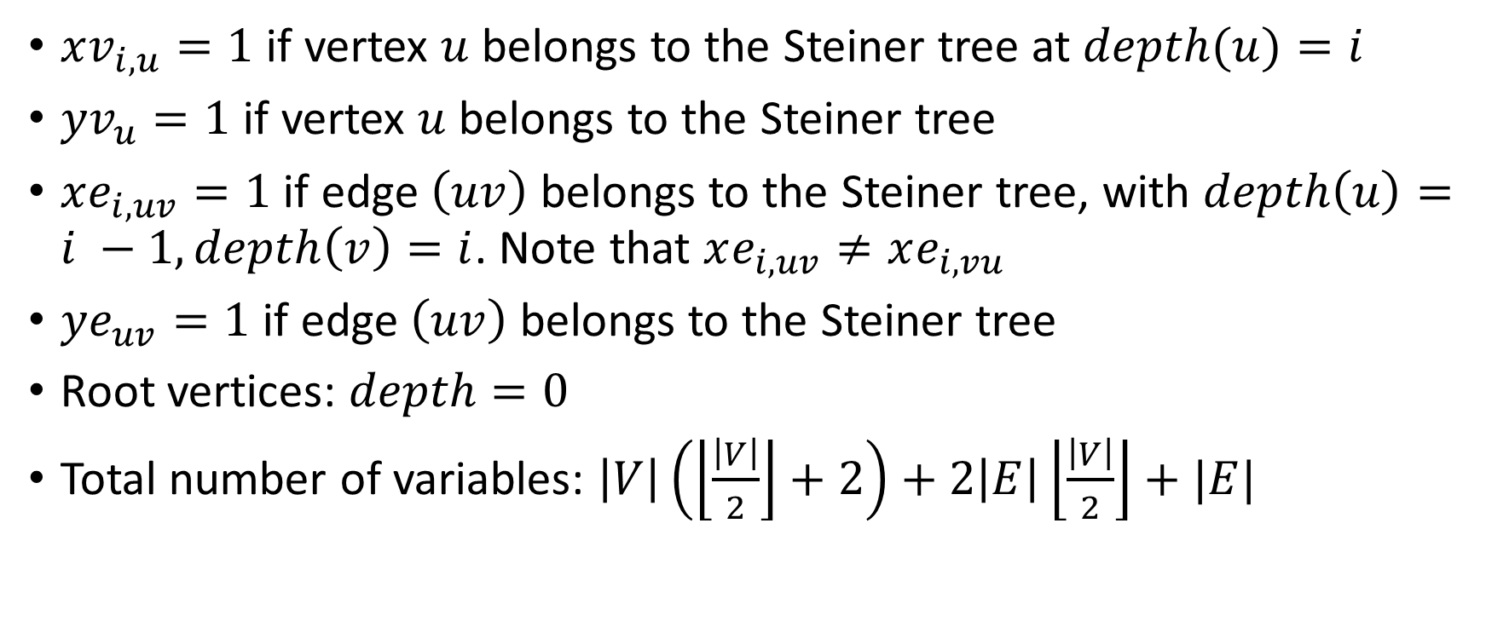
Variables
$xv_{i, u}=1$ if vertex $u$ belongs to the Steiner tree at $depth(u)=i$
$yv_{u}=1$ if vertex $u$ belongs to the Steiner tree
$xe_{i,uv}=1$ if edge $\left(uv\right)$ belongs to the Steiner tree, with $depth\left(u\right)=i −1, depth\left(v\right)=i$. Note that $xe_{i,uv}≠xe_{i,vu}$
$ye_{uv}=1$ if edge $\left(uv\right)$ belongs to the Steiner tree
Root vertices: $depth=0$
Total number of variables: $\left|V\right|\left(\left\lfloor \frac{\left|V\right|}{2}\right\rfloor +2\right)+2\left|E\right|\left\lfloor \frac{\left|V\right|}{2}\right\rfloor +|E|$

Slide 5

Hamiltonian Function (Energy Function)
$$H=H_{obj}+λH_{constraits}$$
$$H_{obj}=\sum_{\left(uv\right)∈E}{\sum_{i=1}^{mxD}{w_{uv}xe_{i,uv}}}$$
$$mxD=\left\lfloor \frac{|V|}{2}\right\rfloor +1$$
$$H_{constraits}=H_{1}+H_{2}+H_{3}+H_{4}+H_{5}+H_{6}$$

Slide 6

Hamiltonian Function (Energy Function)
Only one vertex can be the root
$$H_{1}={\left(1−\sum_{v∈V}{{xv}_{0,v}}\right)}^{2}$$
Terminals must be included in the Steiner tree
$$H_{2}=\sum_{v∈U}{{\left(1−\sum_{i=1}^{mxD}{{xv}_{i,v}}\right)}^{2}}$$
Non-terminals can appear at most ${ye}_{v}$ times
$$H_{3}=\sum_{v∈V\backslash U}{{\left(yv_{v}−\sum_{i=1}^{mxD}{{xv}_{i,v}}\right)}^{2}}$$

Slide 7

Hamiltonian Function (Energy Function)
Each vertex on the tree can have ≤1 edge connected from the ancestor
$$H_{4}=\sum_{x∈V}{\sum_{i=1}^{mxD}{{\left(xv_{i,v}−\sum_{\left(uv\right)∈E}{{xe}_{i,uv}}\right)}^{2}}}$$
If $xe_{i,uv}=1$, then $xv_{i−1,u}=1$ and $xv_{i,v}=1$
$$H_{5}=\sum_{(uv)∈E}{\sum_{i=1}^{mD}{(2−{xv}_{i−1,u}−{xv}_{i,v})}}$$
Edge $(uv)$ can appear at most $ye_{uv}$ times
$$H_{6}=\sum_{\left(uv\right)∈E}{{\left({ye}_{uv}−\sum_{i=1}^{mD}{\left({xe}_{i,uv}+xe_{i,vu}\right)}\right)}^{2}}$$

Slide 8
Convert to QUBO matrix
def get(var = "xv", depth = 0, param1 = 0, param2 = 0):
if (var == "xv"):
if (depth == 0): return param1
return n + (depth - 1) * (n + m) + param1
if (var == "xe"):
if (inEdgeList(param1, param2) == False):
return -1
return n + (depth - 1) * (n + m) + n + edgeList.index((param1, param2))

Slide 9
Convert to QUBO matrix
if (var == "yv"):
return n + (maxDepth - 1) * (n + m) + param1
if (var == "ye"):
if (inEdgeList(param1, param2) == False):
return -1
return n + (maxDepth - 1) * (n + m) + n + edgeList.index((param1, param2))

Slide 10
Solve with Quantum Annealing
chainStrength = uniform_torque_compensation(
bqm=BinaryQuadraticModel.from_qubo(q)
prefactor=__prefactor)
sampler = EmbeddingComposite(DWaveSampler())
response = sampler.sample_qubo(
q,
chain_strength=chainStrength,
num_reads=numReads,
label='Steiner Tree Soltuion',
annealing_time=__annealing_time
)

Slide 11
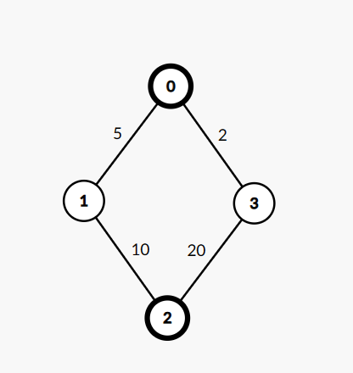

Result (1)
On graph $C_{4}$ with $U=(0,2)$:
Optimal answer is 15

Slide 12
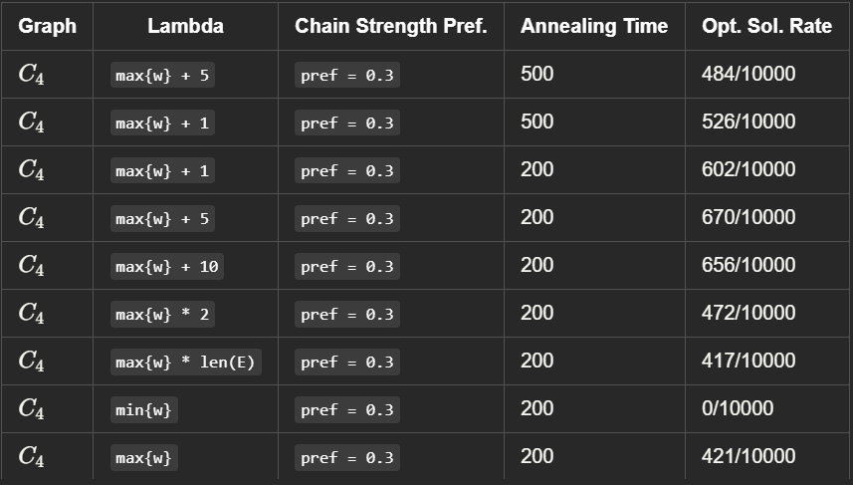

Result (1)
Successful (optimal answer found) rate with varying value of $λ$:

Slide 13
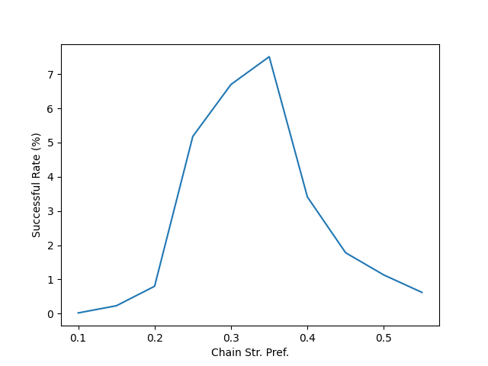
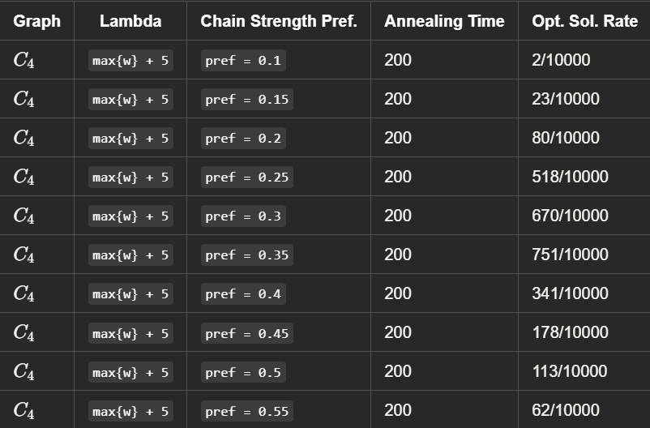
Result (1)
Successful rate with varying chain strength

Slide 14
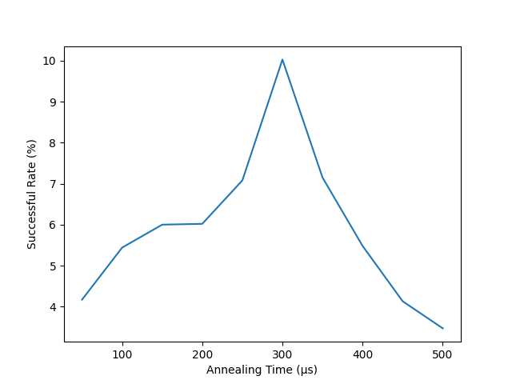
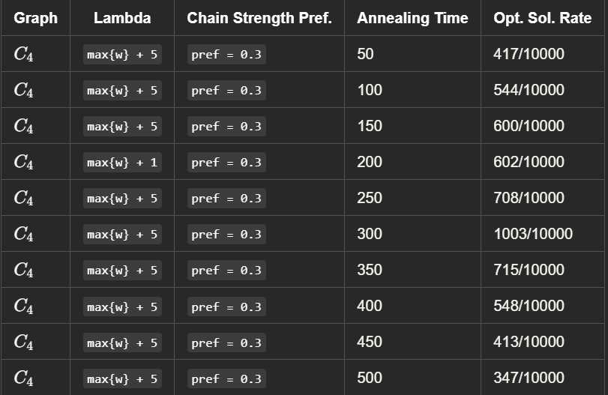
Result (1)
Successful rate with varying annealing time

Slide 15
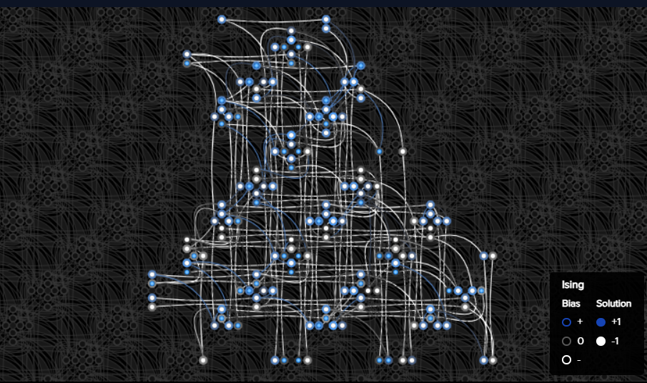
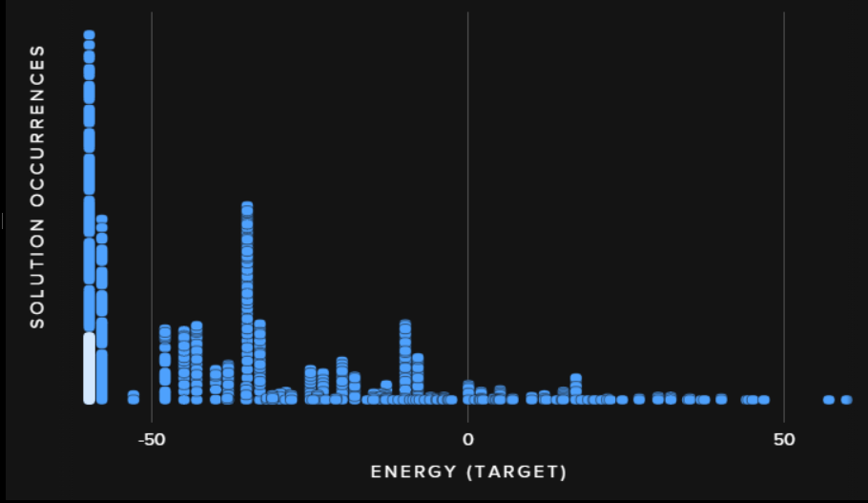
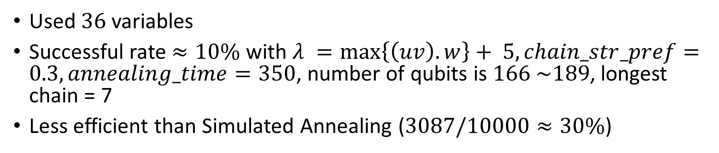
Result (1)
Used $36$ variables
Successful rate $≈10\%$ with $λ =\max\left\{\left(uv\right).w\right\}+ 5,chain_str_pref=0.3, annealing_time=350$, number of qubits is $166 \sim 189$, longest chain = 7
Less efficient than Simulated Annealing ($3087/10000≈30\%$)

Slide 16
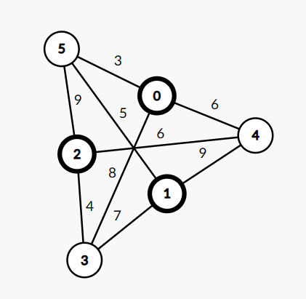

Result (2)
Graph $K_{3,3}$ with $U=\left\{0, 1, 2\right\}$
Optimal solution is $17$ $(\left(0, 5\right), \left(1, 5\right), \left(2, 5\right))$

Slide 17
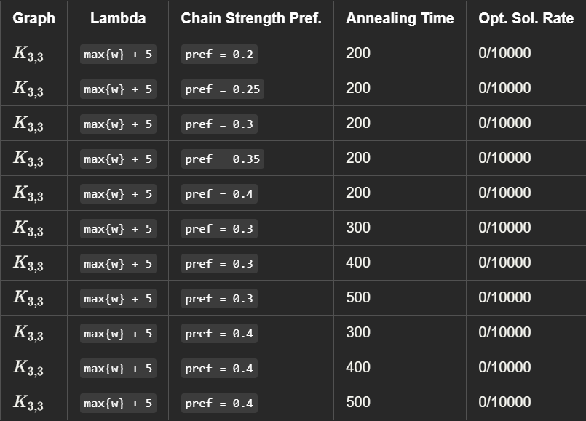
Result (2)
Result is pessimistic …

Slide 18
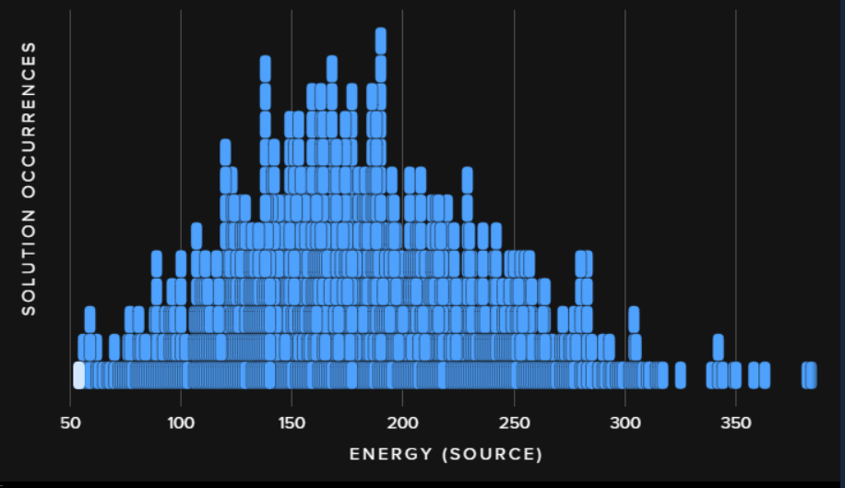

Result (2)
Used 93 variables, $\sim 1045$ qubits, longest chain = 18
No configuration tested provides an optimal solution
Less efficient than Simulated Annealing ($680/10000≈7\%)$

Slide 19
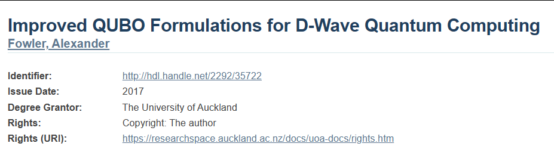
Fowler’s Solution
Mentioned in Improved QUBO formulations for D-Wave quantum computing. Ph.D. Thesis, University of Auckland (2017)

Slide 20
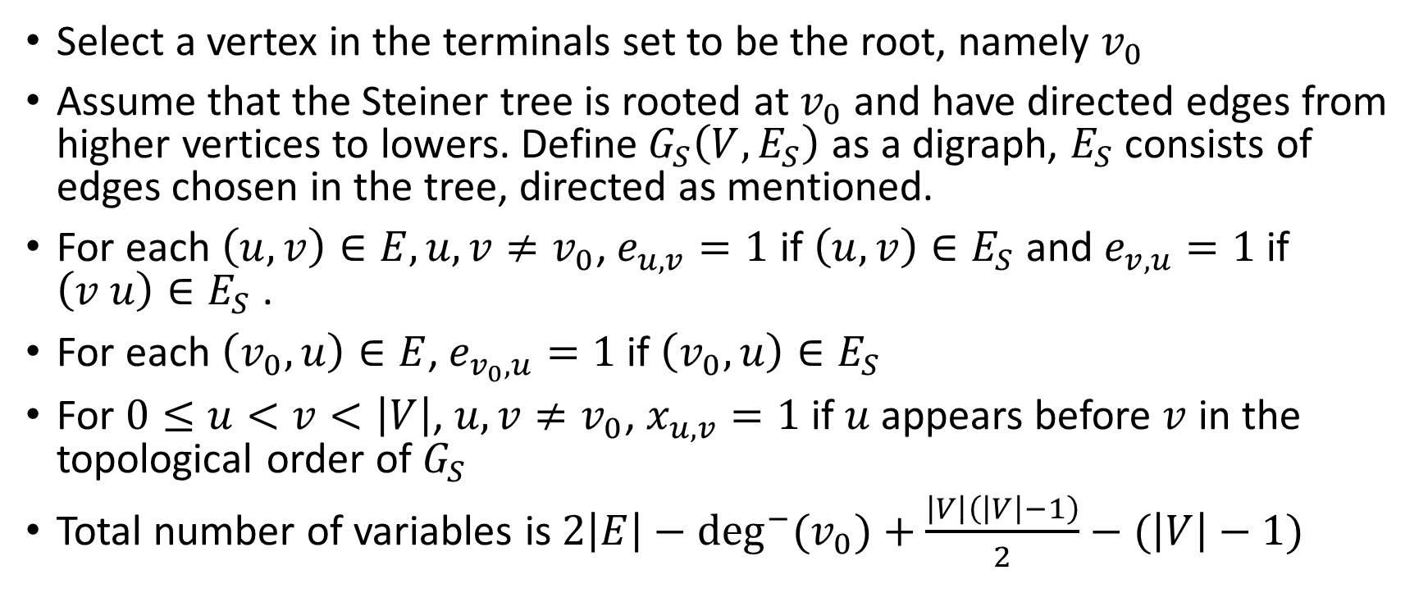
Variables (BQM)
Select a vertex in the terminals set to be the root, namely $v_{0}$
Assume that the Steiner tree is rooted at $v_{0}$ and have directed edges from higher vertices to lowers. Define$G_{S}\left(V, E_{S}\right)$ as a digraph, $E_{S}$ consists of edges chosen in the tree, directed as mentioned.
For each $\left(u, v\right)∈E, u, v≠v_{0}$, $e_{u, v}=1$ if $\left(u, v\right)∈E_{S}$ and $e_{v, u}=1$ if $\left(v u\right)∈E_{S}$ .
For each $\left(v_{0},u\right)∈E$, $e_{v_{0},u}=1$ if $\left(v_{0},u\right)∈E_{S}$
For $0≤u<v<\left|V\right|$, $u, v≠v_{0}$, $x_{u,v}=1$ if $u$ appears before $v$ in the topological order of $G_{S}$
Total number of variables is $2\left|E\right|−\deg^{−}{{(v}_{0})}+\frac{\left|V\right|\left(\left|V\right|−1\right)}{2}−(\left|V\right|−1)$

Slide 21
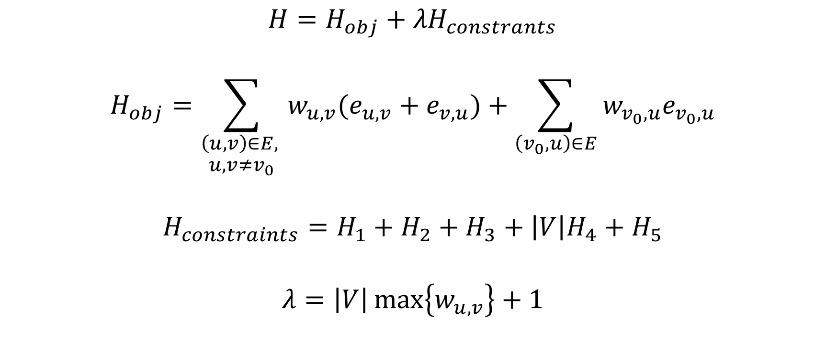
Hamiltonian
$$H=H_{obj}+{λH}_{constrants}$$
$$H_{obj}=\sum_{\begin{aligned}\left(u,v\right)∈E, \\ u, v≠v_{0}\end{aligned}}{w_{u,v}(e_{u,v}+e_{v,u})}+\sum_{\left(v_{0},u\right)∈E}{w_{v_{0},u}e_{v_{0},u}}$$
$$H_{constraints}=H_{1}+H_{2}+H_{3}+\left|V\right|H_{4}+H_{5}$$
$$λ=\left|V\right|\max\left\{w_{u,v}\right\}+1$$

Slide 22

Hamiltonian
$$H_{1}=\sum_{\begin{aligned}0≤u<v<w<\left|V\right|, \\ u,v,w≠v_{0}\end{aligned}}{(x_{u,w}+x_{u,v}x_{v,w}−x_{u,v}x_{u,w}}−x_{u,w}x_{v,w})$$
$$H_{2}=\sum_{\begin{aligned}\left(u,v\right)∈E, \\ u<v, \\ u,v≠v_{0}\end{aligned}}{e_{u,v}\left(1−x_{u,v}\right)+e_{v,u}x_{u,v}}$$

Slide 23
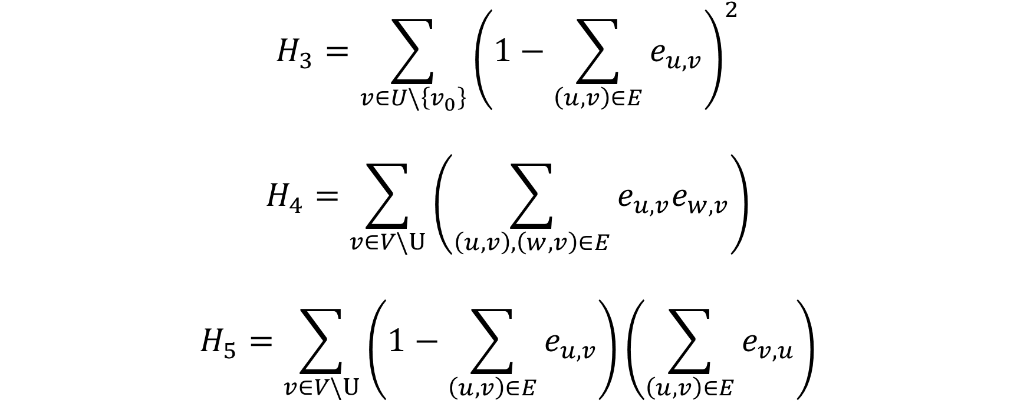
Hamiltonian
$$H_{3}=\sum_{v∈U\backslash \left\{v_{0}\right\}}{{\left(1−\sum_{\left(u,v\right)∈E}{e_{u,v}}\right)}^{2}}$$
$$H_{4}=\sum_{v∈V\backslash U}{\left(\sum_{\left(u,v\right),\left(w,v\right)∈E}{e_{u,v}e_{w,v}}\right)}$$
$$H_{5}=\sum_{v∈V\backslash U}{\left(1−\sum_{\left(u,v\right)∈E}{e_{u,v}}\right)\left(\sum_{\left(u,v\right)∈E}{e_{v,u}}\right)}$$

Slide 24

Result (1)
$C_{4}$ with $U=\{0,2\}$ as above, optimal answer is $15$

Slide 25
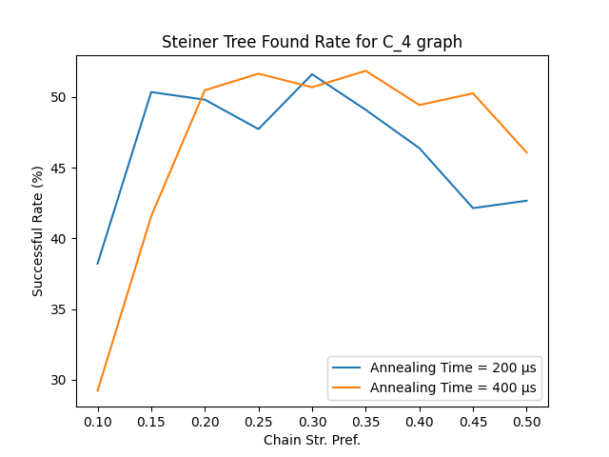
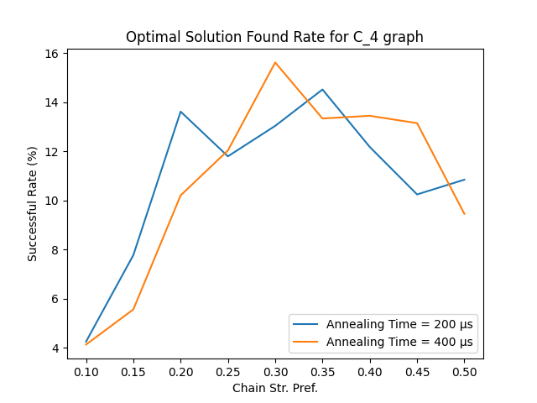
Result (1)

Slide 26
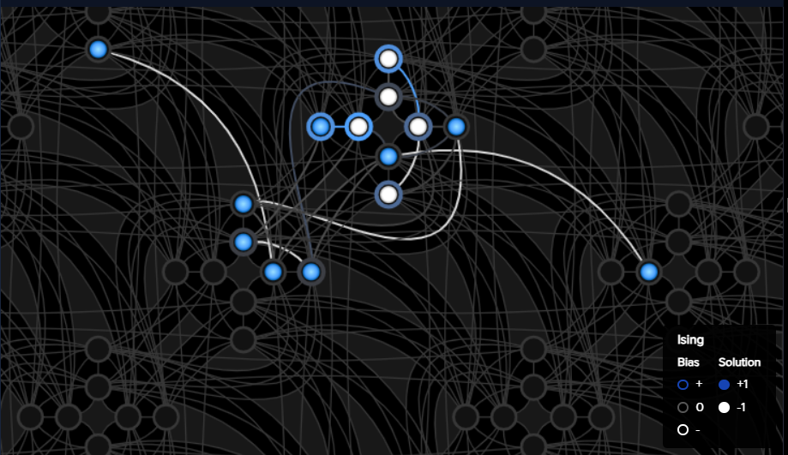

Result (1)
$9$ variables embedded to $≈15$ qubits

Slide 27
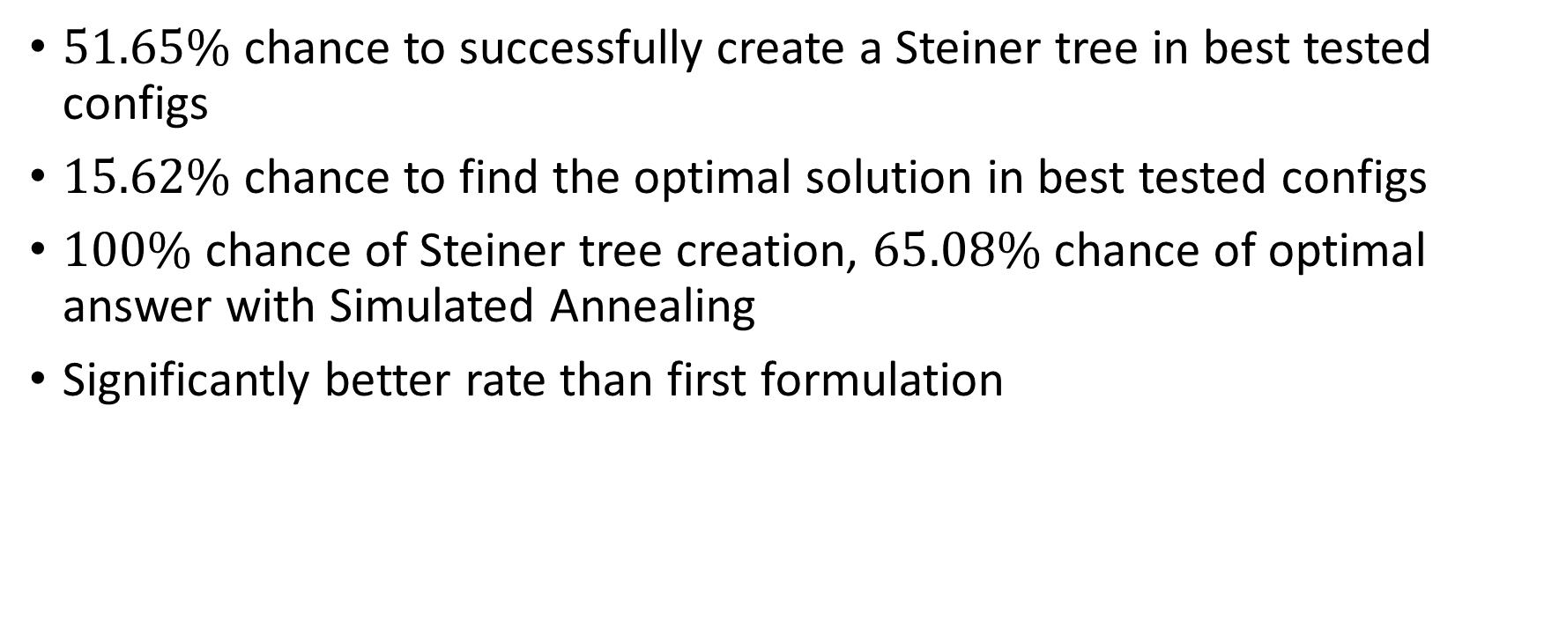
Result (1)
$51.65\%$ chance to successfully create a Steiner tree in best tested configs
$15.62\%$ chance to find the optimal solution in best tested configs
$100\%$ chance of Steiner tree creation, $65.08\%$ chance of optimal answer with Simulated Annealing
Significantly better rate than first formulation

Slide 28

Result (2)
$K_{3,3}$ with $U=\{0,1,2\}$ as above, optimal answer is $17$

Slide 29
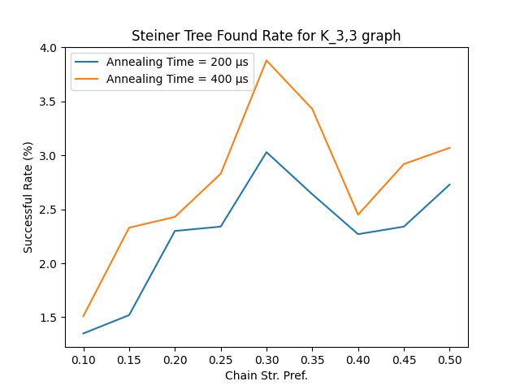
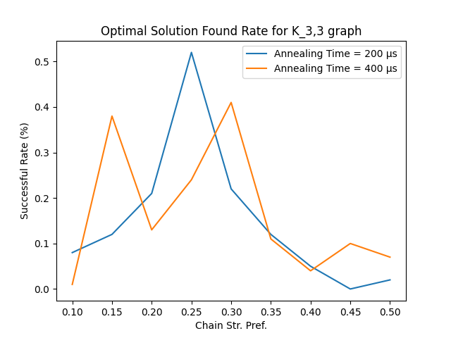
Result (2)

Slide 30
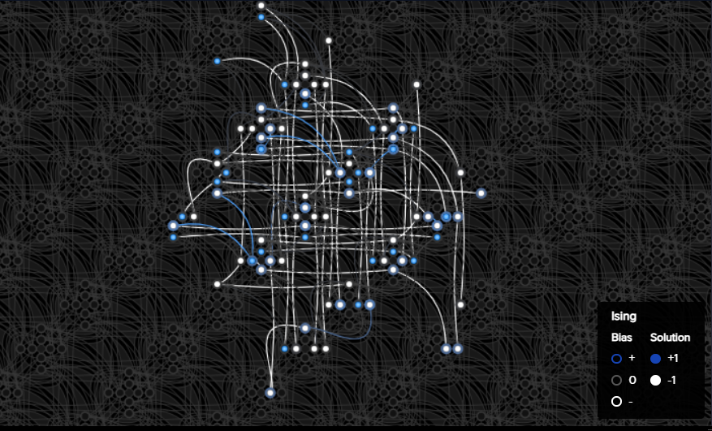

Result (2)
$26$ variables embedded into $≈90$ qubits

Slide 31
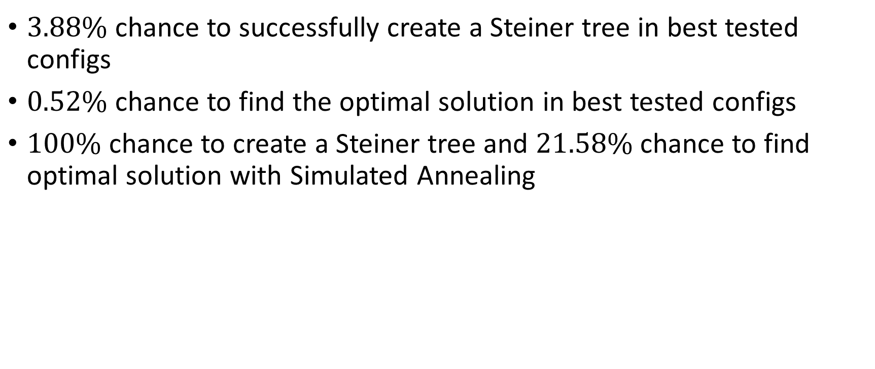
Result (2)
$3.88\%$ chance to successfully create a Steiner tree in best tested configs
$0.52\%$ chance to find the optimal solution in best tested configs
$100\%$ chance to create a Steiner tree and $21.58\%$ chance to find optimal solution with Simulated Annealing

Slide 32
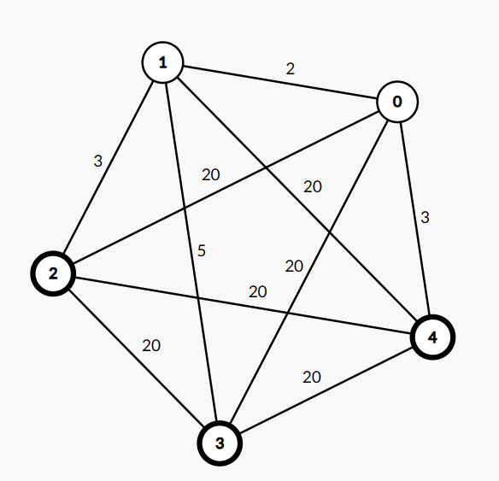

Result (3)
Complete graph $K_{5}$, $U=\left\{2, 3, 4\right\}$
Some edges have smaller weights
Optimal solution is $13$

Slide 33
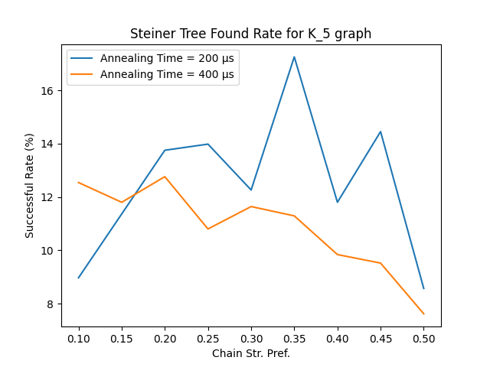
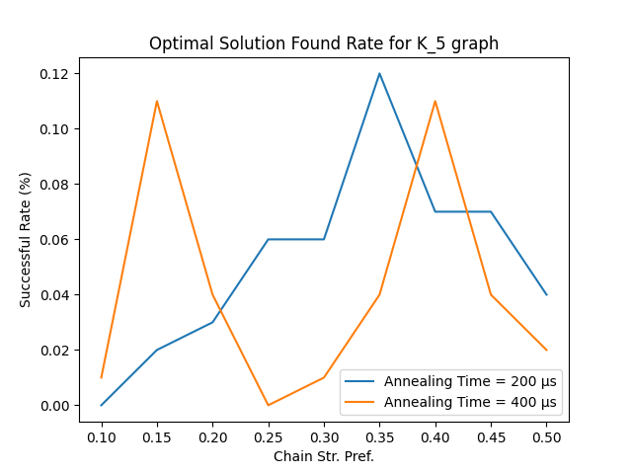
Result (3)

Slide 34
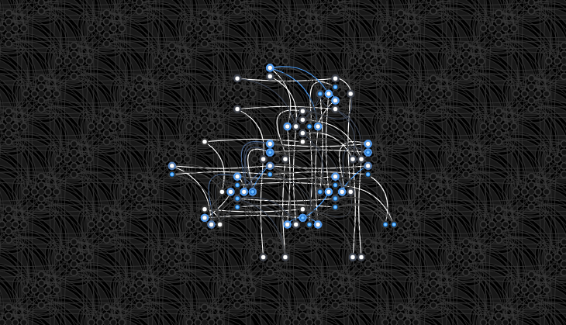

Result (3)
$22$ variables embedded into $≈65$ qubits

Slide 35
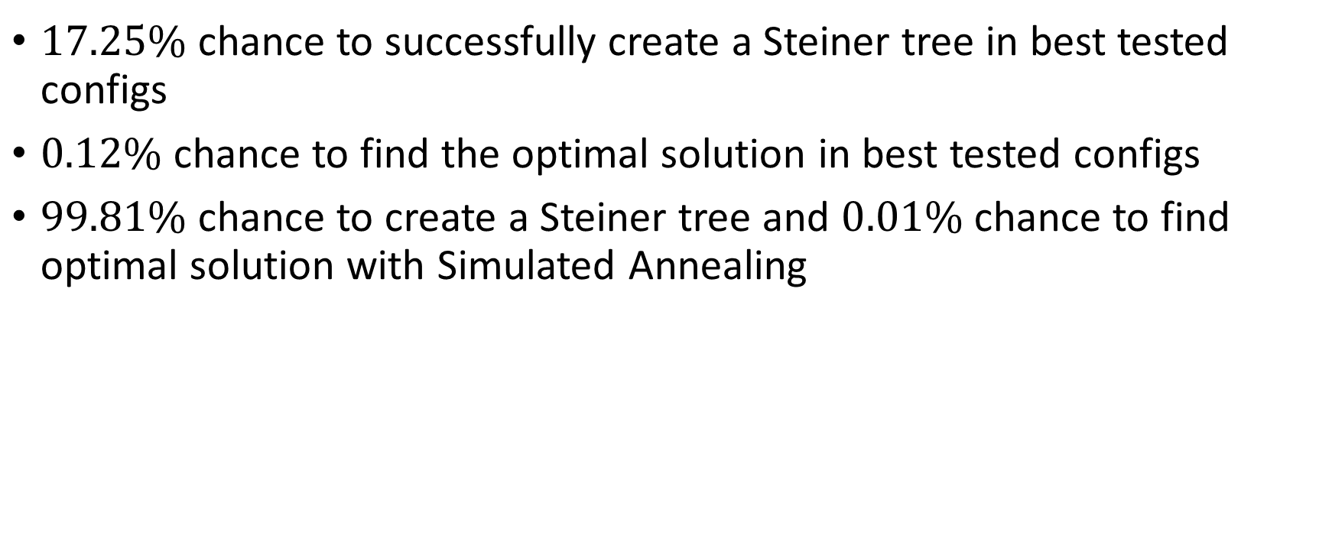
Result (3)
$17.25\%$ chance to successfully create a Steiner tree in best tested configs
$0.12\%$ chance to find the optimal solution in best tested configs
$99.81\%$ chance to create a Steiner tree and $0.01\%$ chance to find optimal solution with Simulated Annealing

